Slide 1
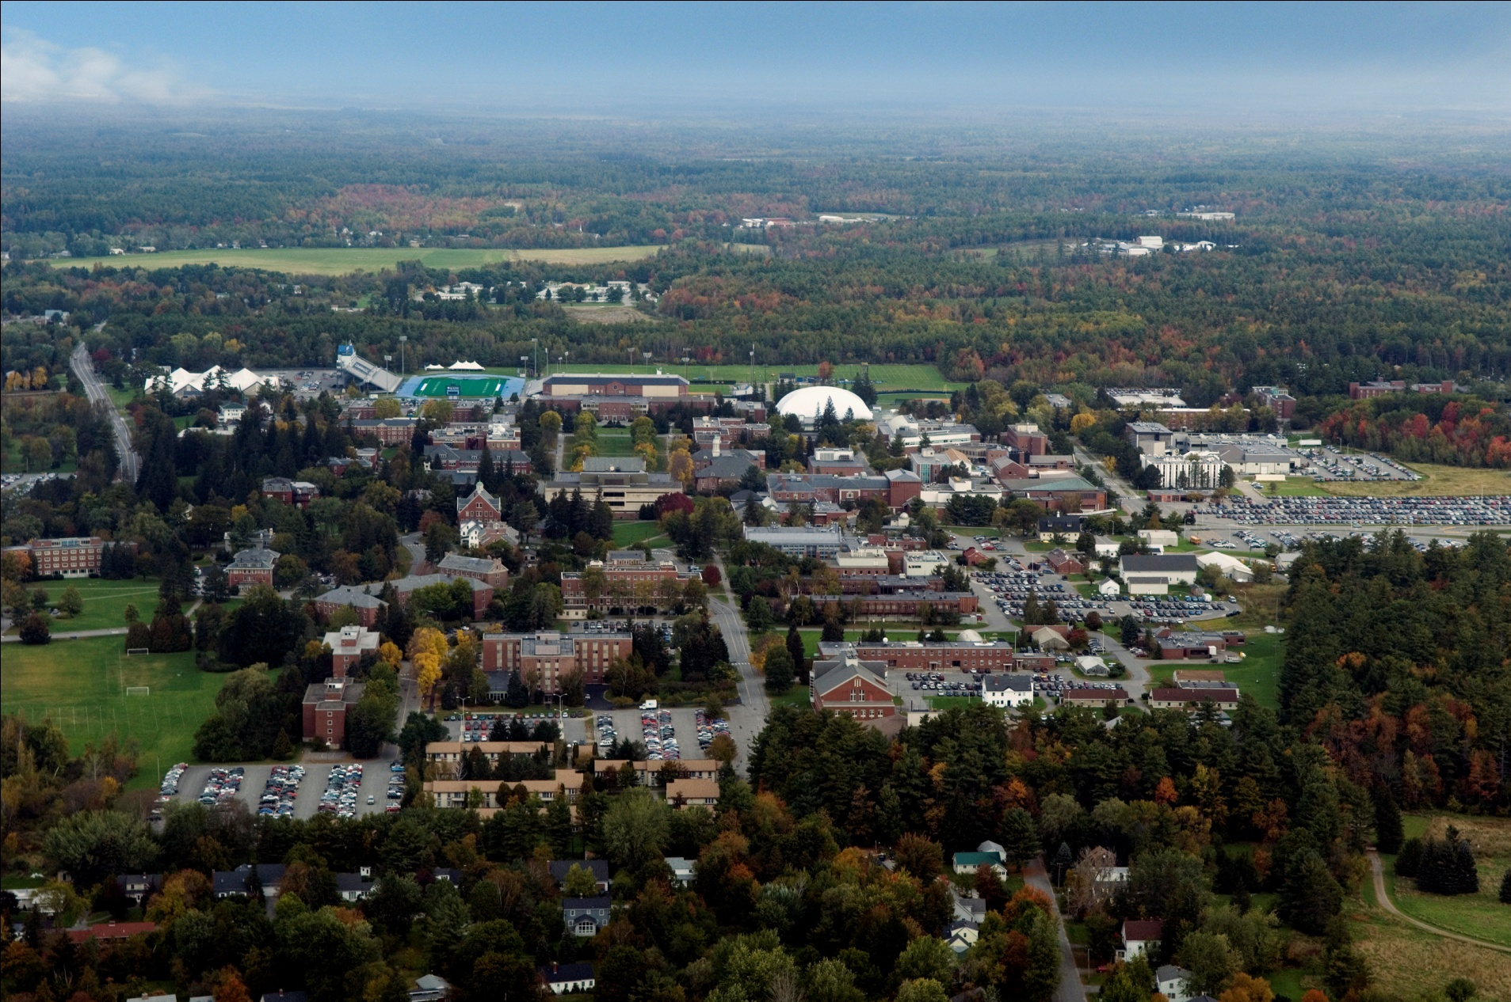
Clean Tech Corridor
Umaine’s Capacity and Assets
Jake Ward,

Slide 2
Types of Partnerships
Collaborative Research
Contract Research
Industrial Consortia
Contract Service
Access to facilities and equipment
Student Projects
Internship, Co-ops

Slide 3
Play Video

Slide 4
Innovation Continuum – R,D,& C
Its Cyclical – not Linear
Production/
Public Access
Basic Research
Development
Demonstration
+$$
Applied Research
Commercialization
$ Fed Grants
DoD ,DOE ,USDA.
$ SEGF----VC ---Equity--- Debt
$ Fed Grants – NIH,NSF, etc.
$$ -MTI
Seed Grants, Development Awards, ACF
Fed SBIR
-$$
$ Company Funds – Family, Fools and Friends
Science & Technology Drives
Business & Markets Drive
Univ and Non-profit
R&D
Valley of Death
Commercial R&D

Slide 5
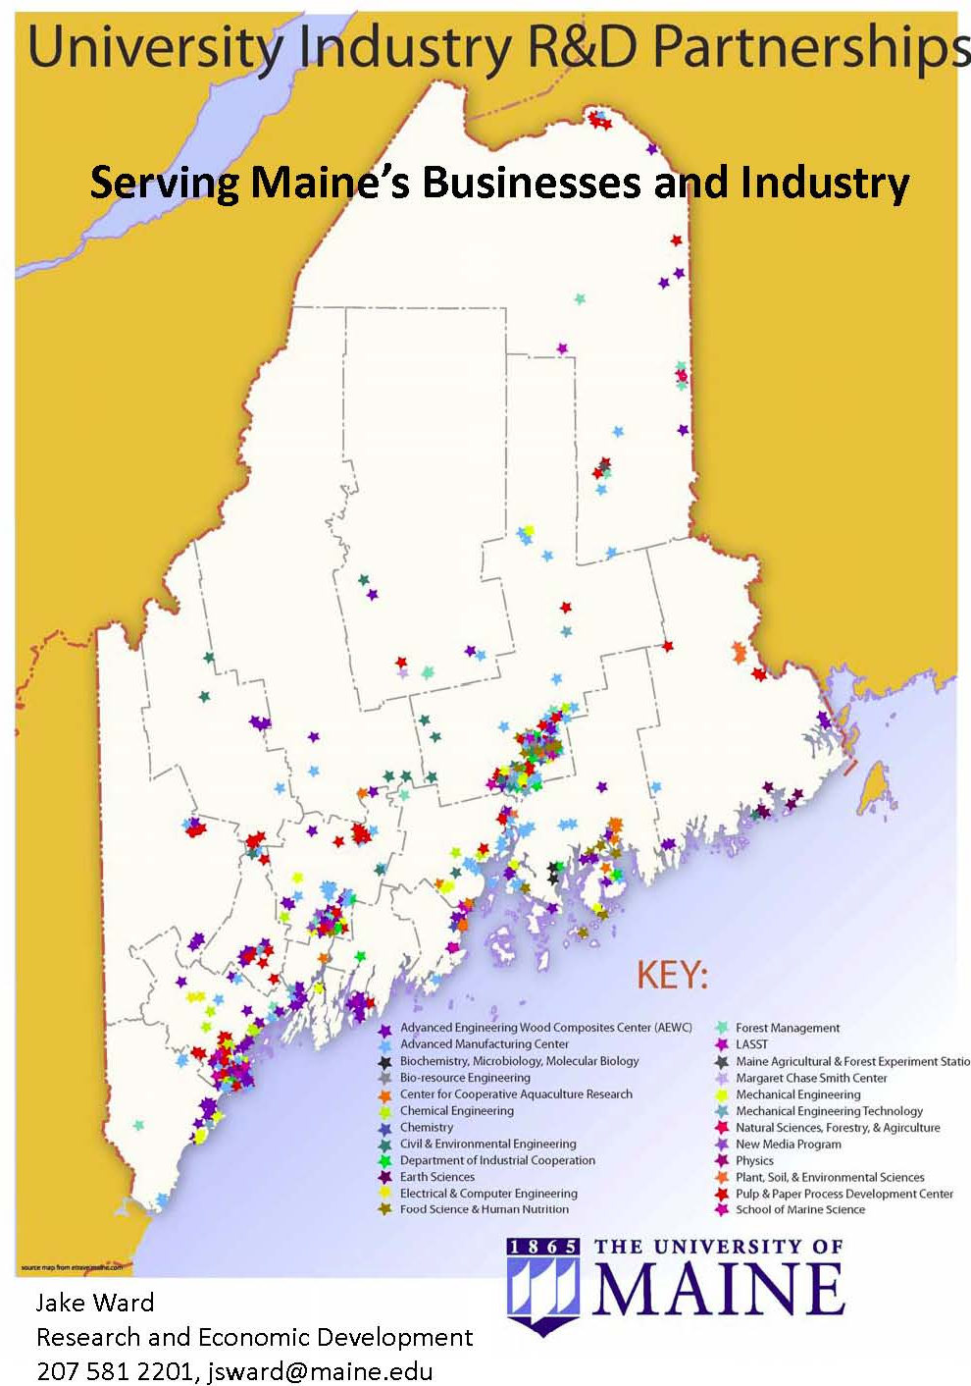
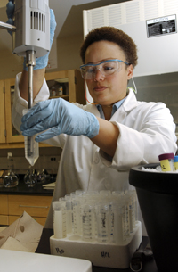
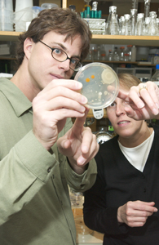
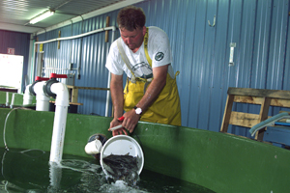
The University of Maine has R&D activity with hundreds of Maine companies throughout the State.

Slide 6
Collaborative Research
Common theme to explore
Company/University partner with or without outside funding
  Federal, state, other funding programs
  Co-proposers or prime/sub contractors
  Examples: NIST ATP, DOE NICE3, SBIR/STTR - Company lead
  More traditional NSF, NIH, DOD - University lead
  Simple joint collaboration with no external funds

Slide 7
Contract Research
Company has identified a specific problem or need
Fee for service project developed
solutions can be proprietary to company

Slide 8
Industrial Constoria
Group of companies with common theme
Annual contribution support research program
Consortium provides research direction
Results shared with consortium

Slide 9
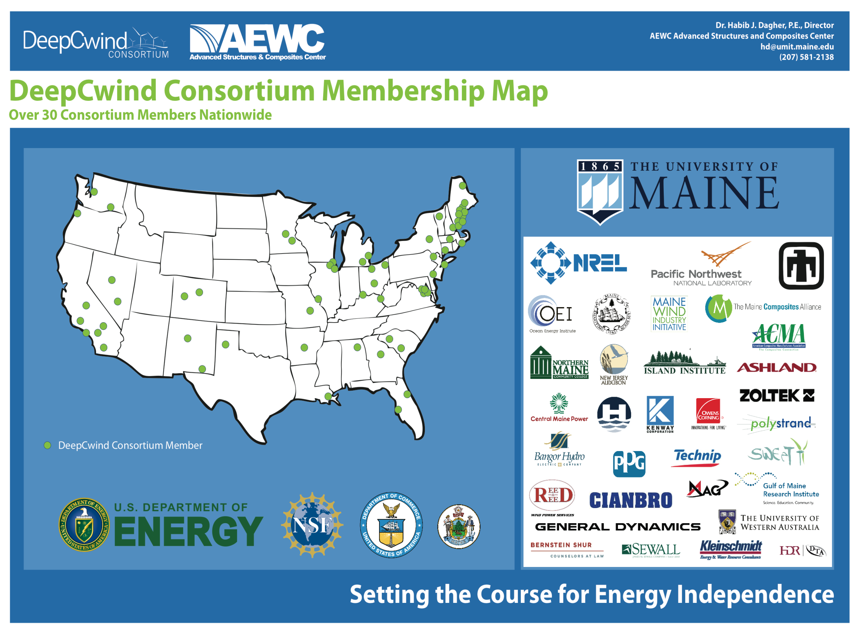

Slide 10
Contract Service
Specialized services
  Testing, analysis, technical training that may not exist in private sector
Company specific, fee for service
Based on existing capabilities, staff and facilities
Sometimes student involvement

Slide 11
Access to Facilities and Equipment
Company has their personel use labs and/or equipment
Usually fee for service based on the equipment and duration
Company assumes liability for their people and damages

Slide 12
Technology Transfer
UMaine Technology for License and Commercialization
Company commercializes – royalty to UM
Joint Inventions
Existing Companies or Start-ups

Slide 13
Student Projects
Class design, senior capstone projects
Company provides topics, some materials and supplies cost, and advice
Typically fall within one or two semesters

Slide 14
Internships and Co-ops
Opportunities for student experience
Companies get to see students before graduation
Some formal programs (P&P), most departments will facilitate
New – Renewable Energy Summer 2011
New – Innovation Engineering Summer 2012

Slide 15
Looking at Partnerships - Leveraging Resources
“Clusters”
+$$
Basic Research
Development
Demonstration
Production
Applied Research
Commercialization
Start-ups
& SME’s
A lot in Maine!
Large Co’s
Fewer in Maine
53 over 500
employees
Research Univ.
Fed Labs.
Non-profits
Size-varies
Valley of Death
Who is working with who?

Slide 16
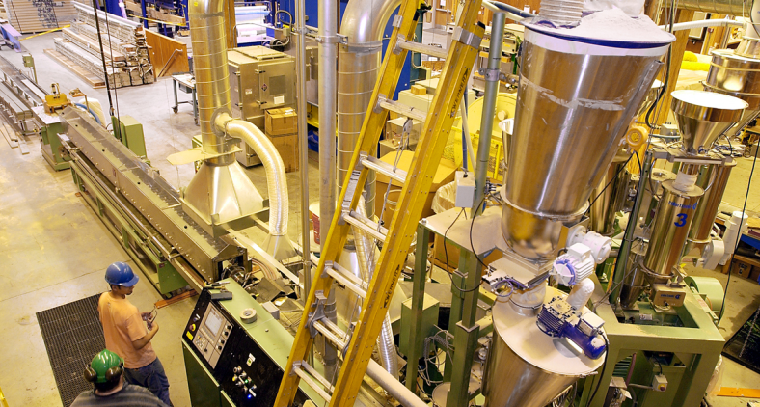
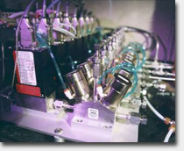
R&D /Tech Transfer
Pilot Plant Facilities
University and Partners can do real scale development and demonstration projects
Companies can buy time to do prototyping and small production, troubleshooting projects
Examples
  Pulp and Paper Development Center,
  Forest Bio-products Research Institute
  Food Science Pilot Plant,
  Center for Cooperative Aquaculture Research,
  Advanced Engineered Wood Composites Center,
  Laboratory for Surface Science and Technology,
  Target Technology Center Super-computer,
  Advanced Manufacturing Center,
  Zebra fish Facility
  Small Animal Facility (AAALAC pending)
  MAFES Farms
Notes:
Anita mentioned that they have a “new approach” to construction management – manager must be Maine contractor

Slide 17
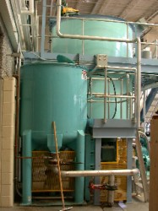
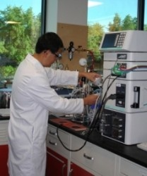
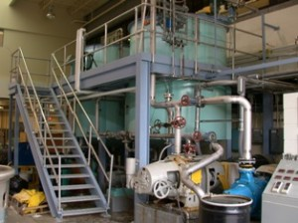
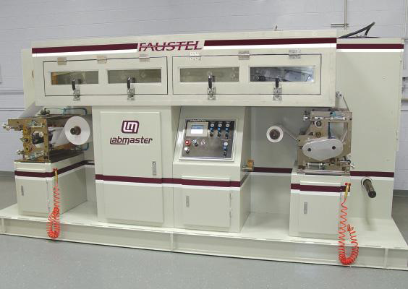
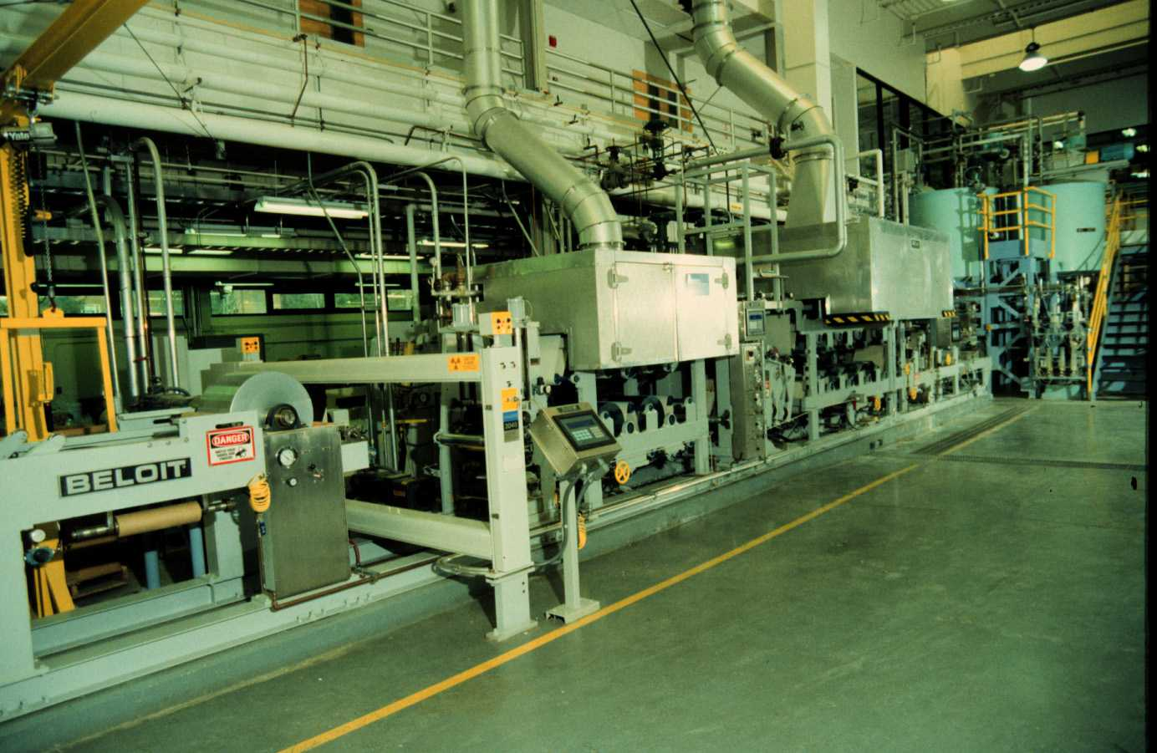
Process Development Center
Home-Grown Energy Crop - an alternative energy crop that could help save Maine’s farms.
Sustainable Bioplastics –efforts to establish a sustainable bioplastics industry in Maine, see Mainebiz
Pilot Web Coater at PDC – The PDC’s new Web Coater available for your research. To learn more, click here.
New Retention Technology – UMaine and Cerealus launch Ceregel™, a new retention technology that strengthens paper, reduces material loss, and lowers costs.
Sawdust to Heating Fuel – Our partner, Biofine works to convert sawdust to heating fuel.
Advanced Cellulose Insulation – PDC and Green Comfort Safe awarded Technology Transfer Award to develop improved Cellulosic Insulation.

Slide 18


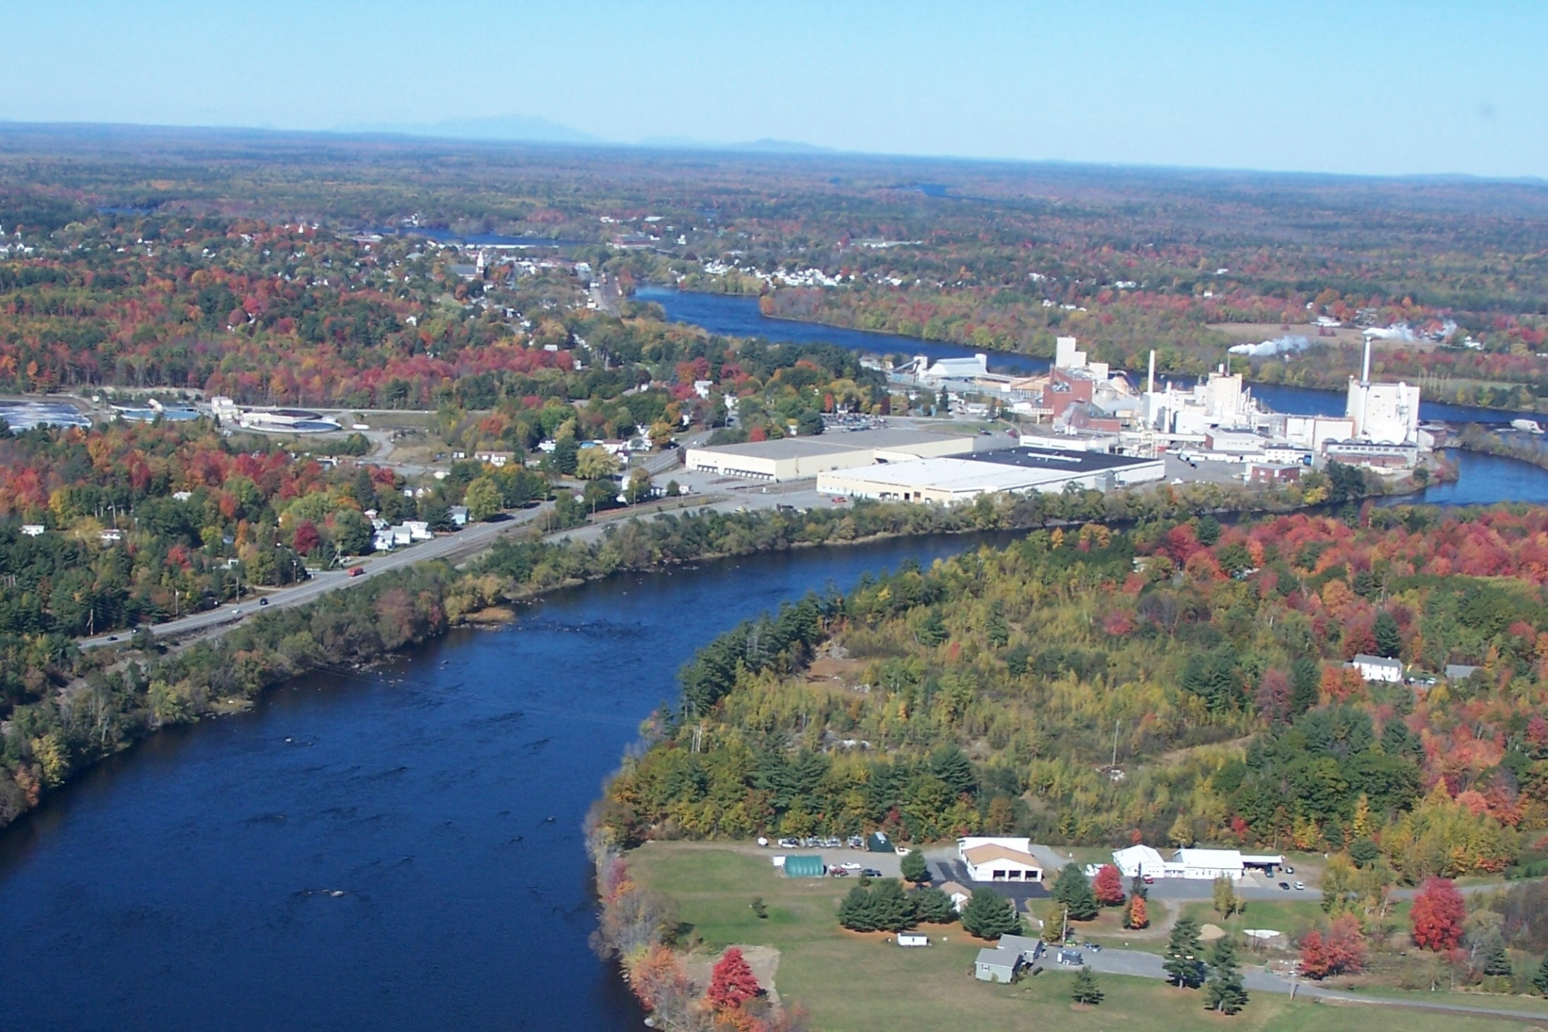

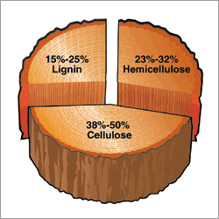

US Patent # 7,824,521

Slide 19
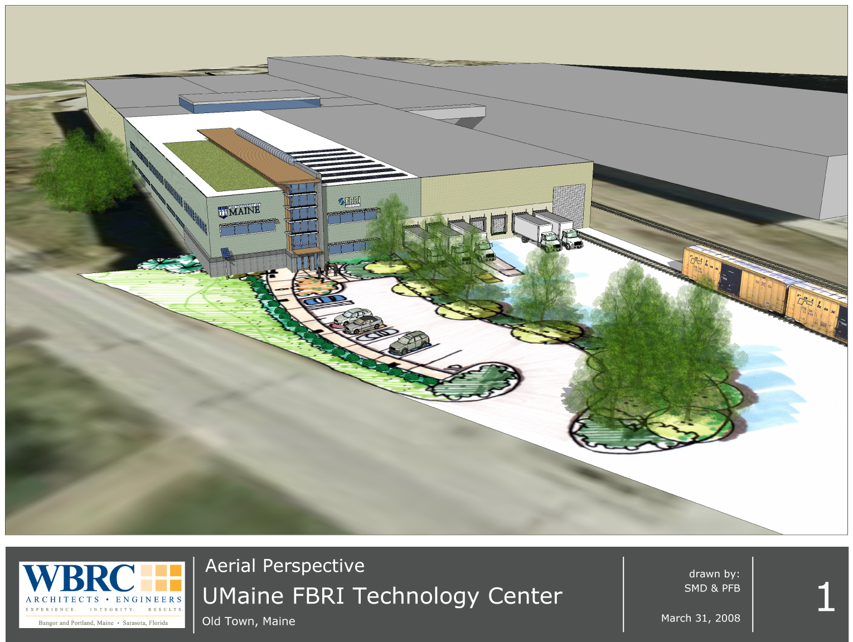
PROJECT GOALS:
Target $5,000,000 Total Project Cost.
Program flexibility
Plan efficiency
LEED Certification
Prefabricated modular components
Notes:
19

Slide 20

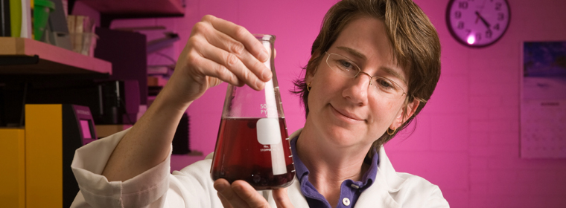
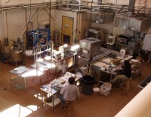
Better Process Control
Product and Process Review
Consumer Sensory Testing
Grant Writing Support/Review
Food Processing
Analytical Consulting
Shelf life studies
Food product development
R&D for trouble-shooting issues
Commercial Kitchen Facilities
Su
Food Processing Pilot Plan

Slide 21
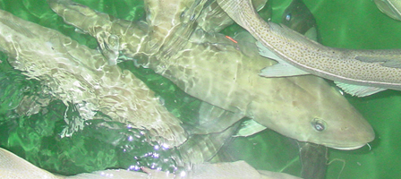
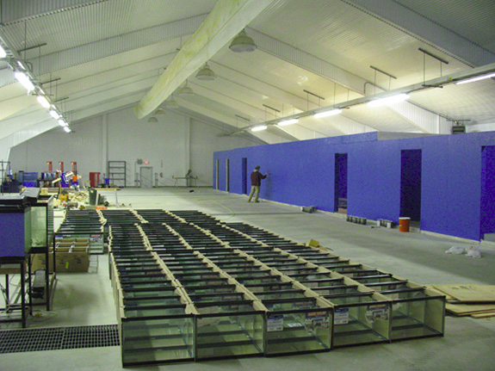
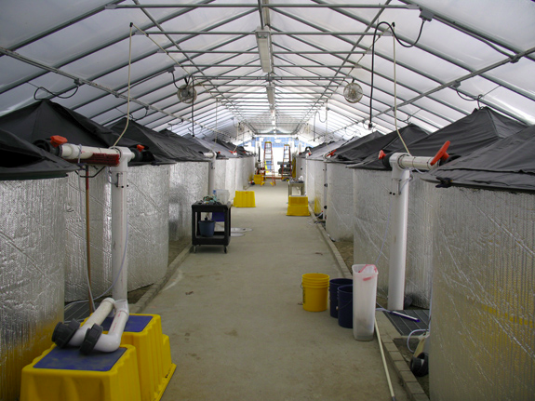

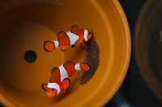
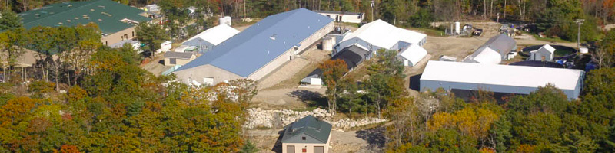
Center for Cooperative Aquaculture Research, Franklin Maine
Marine Species - Cod, Halibut, Worms, Urchins, Nori, tropicals
Recirculation Technology
Bio-filtration
Integrated Aquaculture
Business Incubation

Slide 22


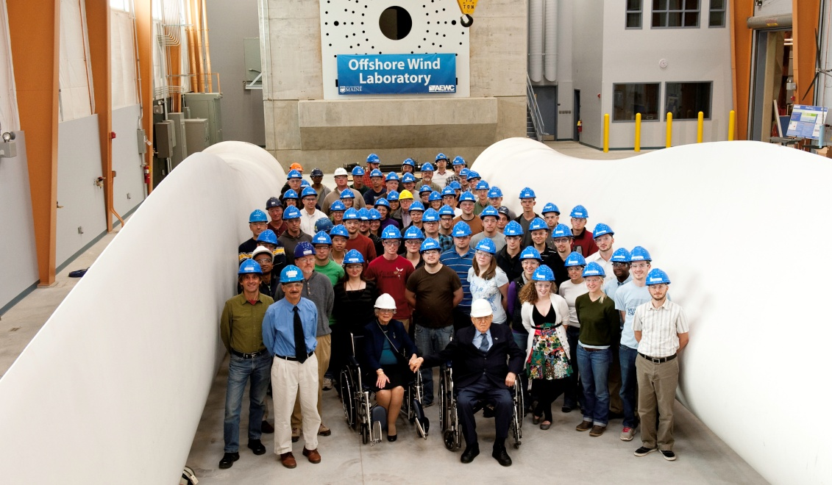
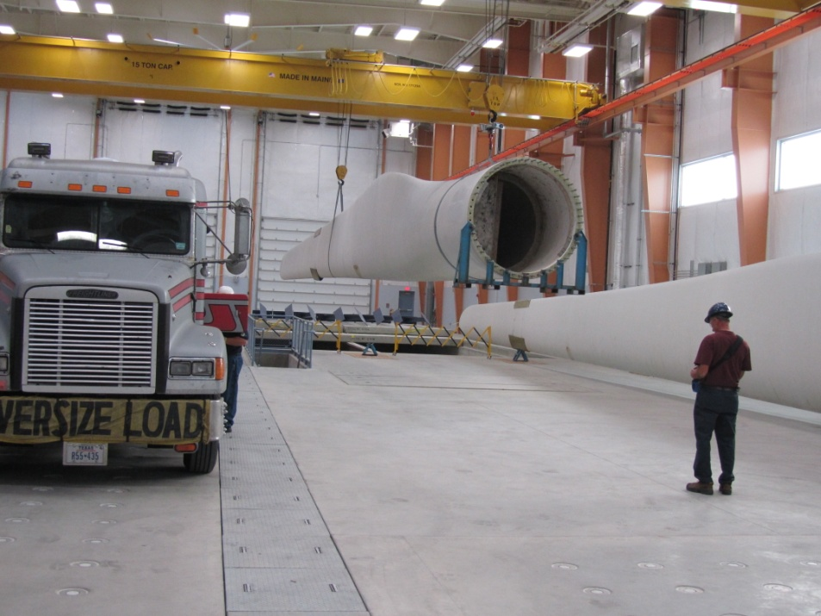
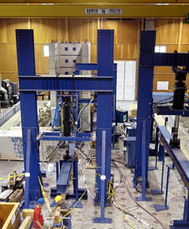
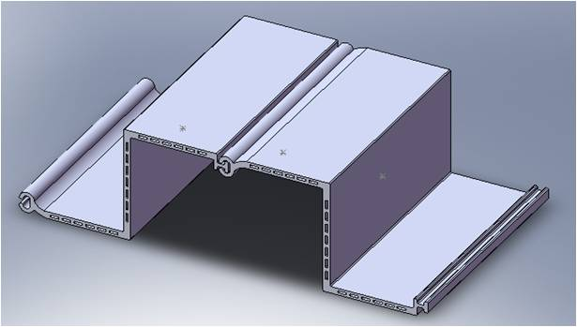
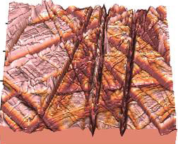

UMaine Research, Development Commercialization
$100 Million Annual Enterprise – 600+ Jobs
Top 100 Nationally

Slide 23

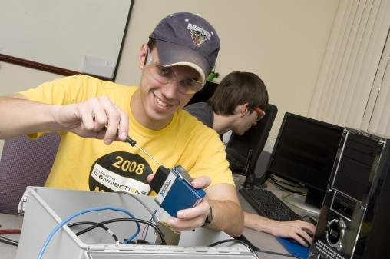
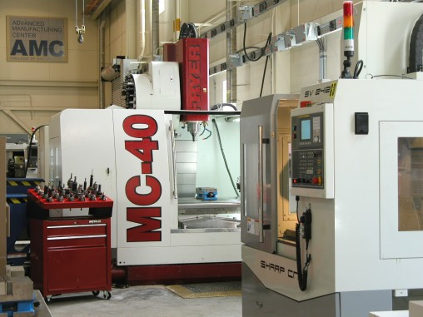
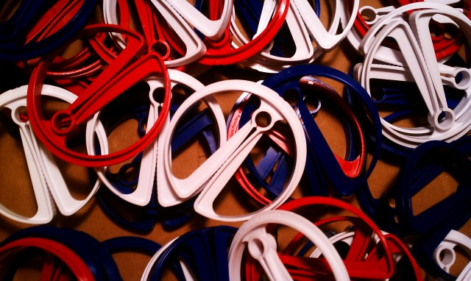
Provides “one-stop rapid-response center” and engineering support for manufacturing industries
Equipment
3d Scanning and Design
4 Axis CNC Machining Centers
CNC Lathes
Fabrication and Welding
Rapid Prototyping
CMM coordinate measuring
EDM

Slide 24
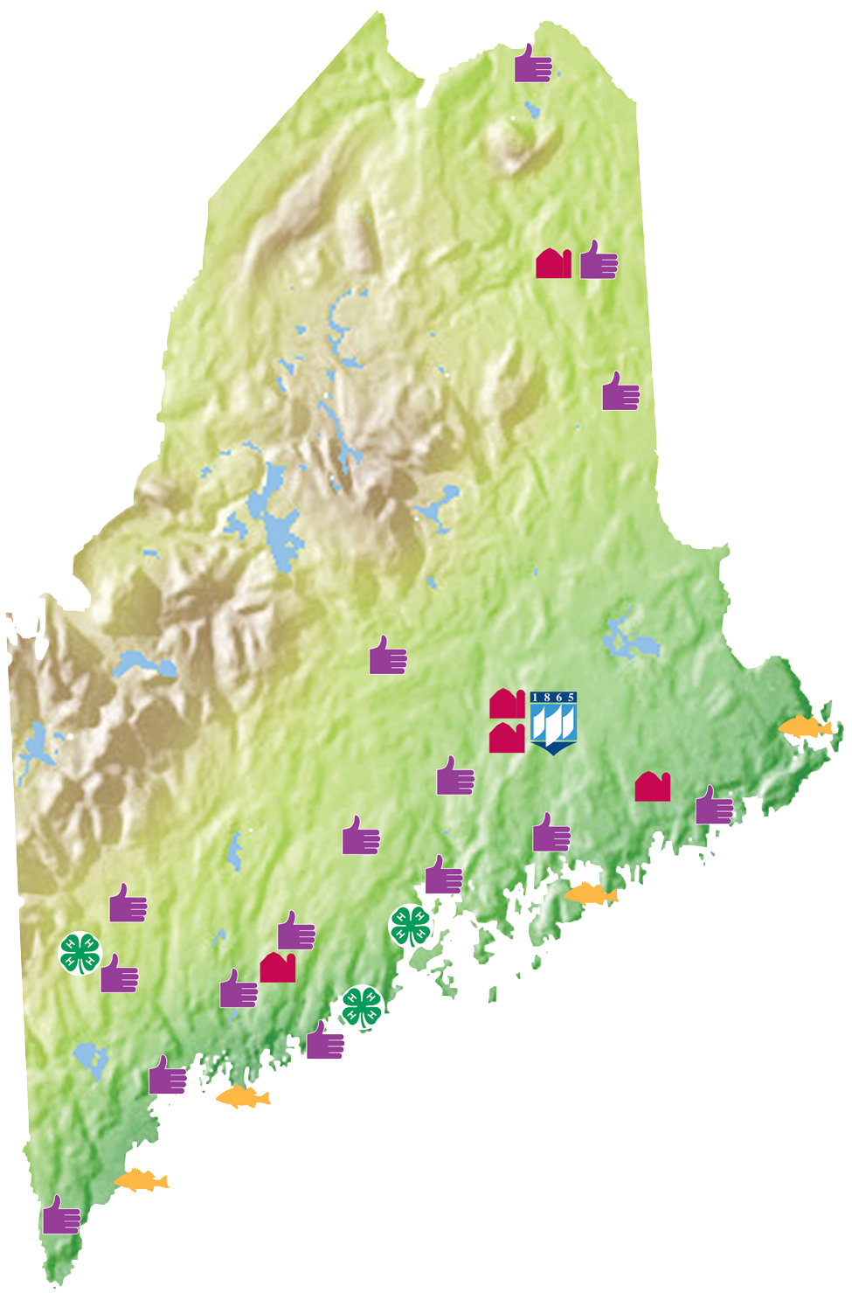
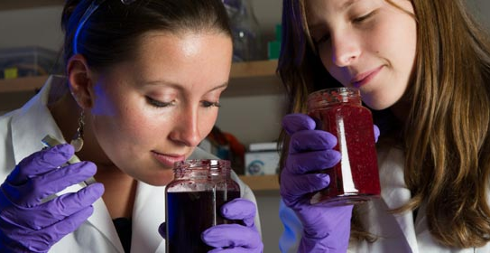
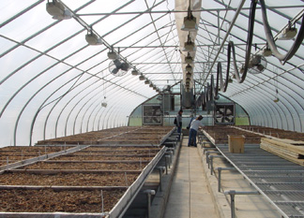
Cooperative Extension
State Wide Sites
 | Cooperative Extension County Offices
 | MAFES Research Facilities/farms
 | Cooperative Extension 4-H Camps
 | Marine Extension Team Facilities
Variety Development, Field trials,
Technology Demonstrations

Slide 25

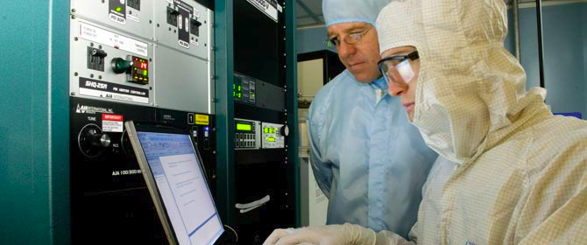
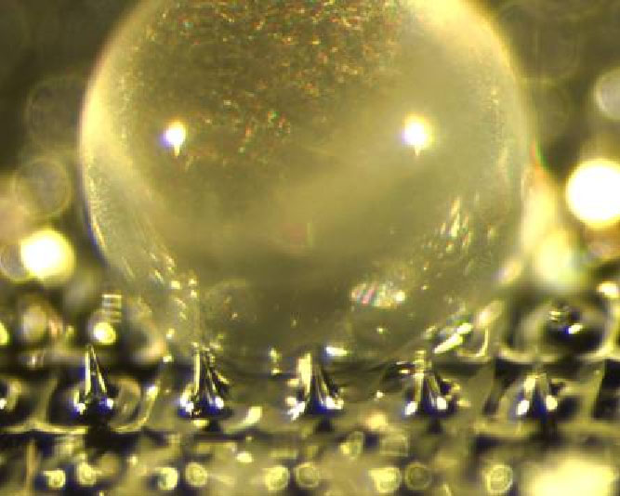
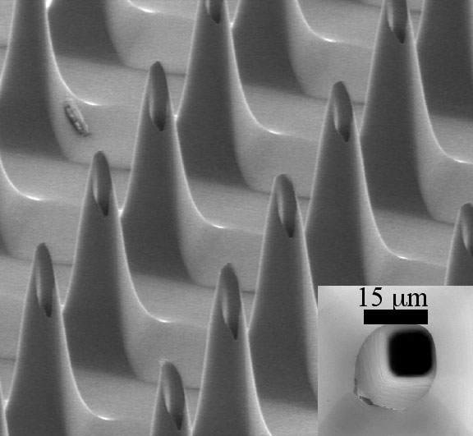
Nanotechnology
Thin films
Environmental Sensors
Bio Sensors
Ultra-high Temp Sensors

Slide 26
Business Help
Expertise in sustainable business.
organizes programs on sustainable efforts, green projects, recycling
* Contact: Dr. Terry Porter, Assistant Professor of Management
Providing expertise to local businesses
  Knowledge Transfer Alliance, a $1.8M grant from US Dept of Commerce,EDA
  to help businesses cope with economic downturn
  Combining efforts of business and economics faculty and student
  Contact: Hugh Stevens
Maine Business School
* Programs and courses in accounting, finance, entrepreneurship, international business, management, and marketing
* Faculty with national and global expertise
* Active links, through alums and projects, with Maine businesses in the energy, finance, and consulting sectors
* Contact: Dr. Ivan Manev, Interim Dean,
  imanev@maine.edu or 207-581-1968

Slide 27
For More Info
Jake Ward – jsward@maine.edu
Renee Kelly - rwkelly@maine.edu
John Belding -john.belding@maine.edu

